Slide 1
Cybersecurity for Journalists (and Everyone!)
Thursday, February 23, 2017
Media School
Indiana University

Slide 2
Panelists
Nate Cardozo, Electronic Frontier Foundation
Anthony L. Fargo, IU Center for International Media Law and Policy
Marisa Kwiatkowski, Indianapolis Star
Susan Sons, IU Center for Applied Cybersecurity Research

Slide 3
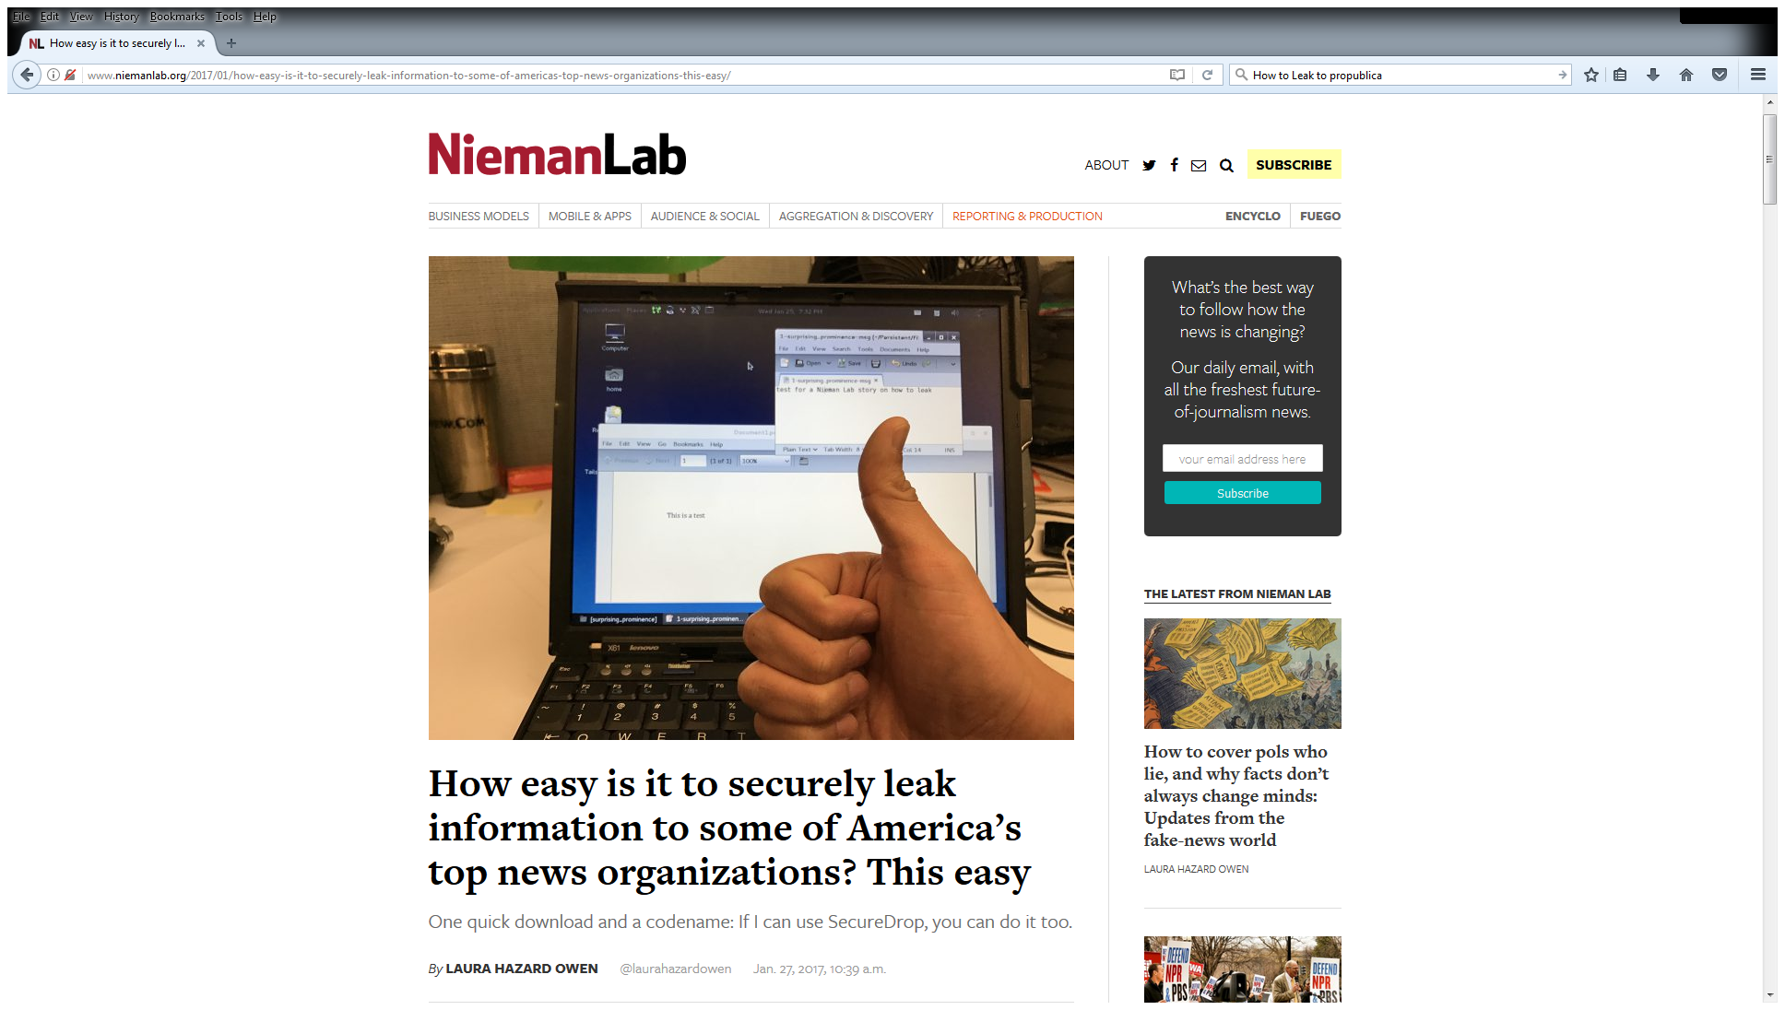

Slide 4
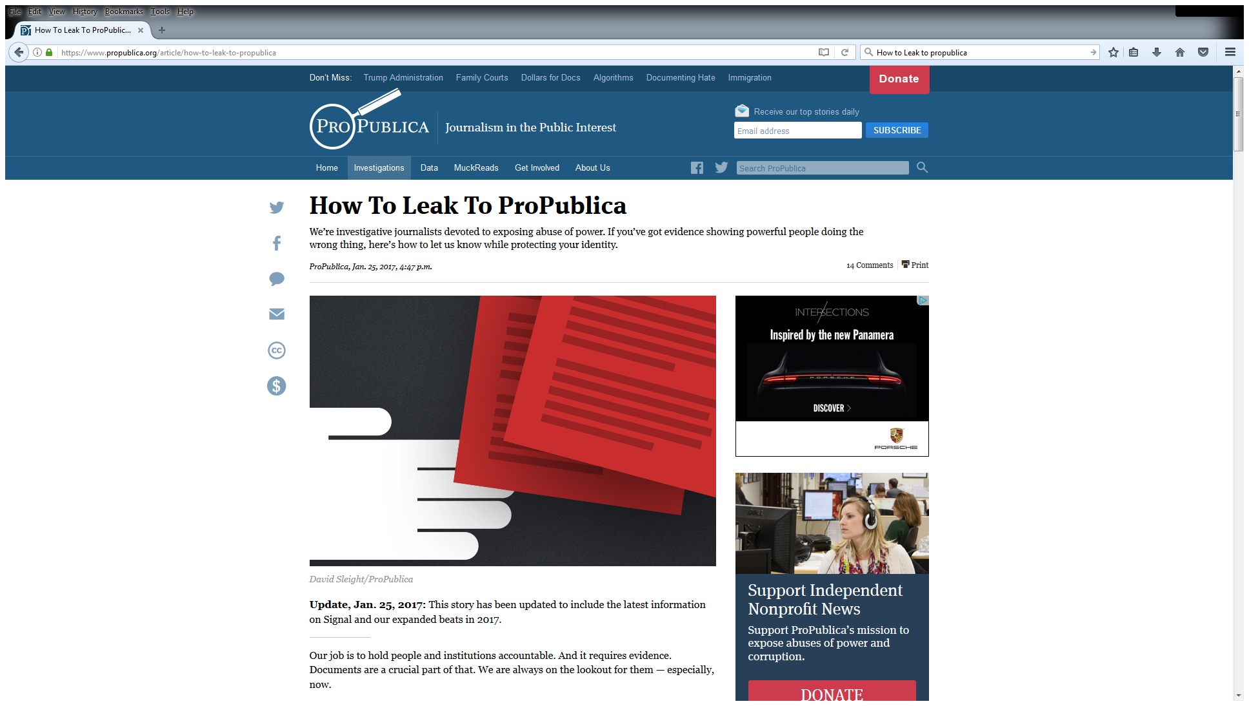

Slide 5
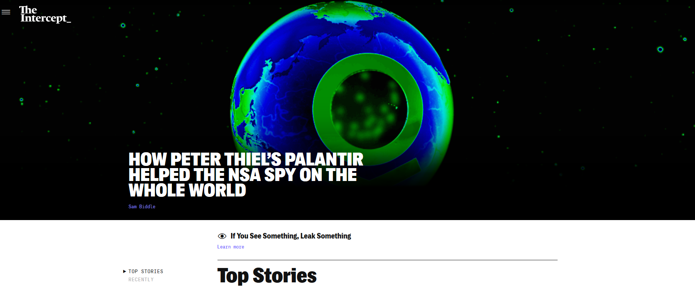
“If You See Something, Leak Something”

Slide 6
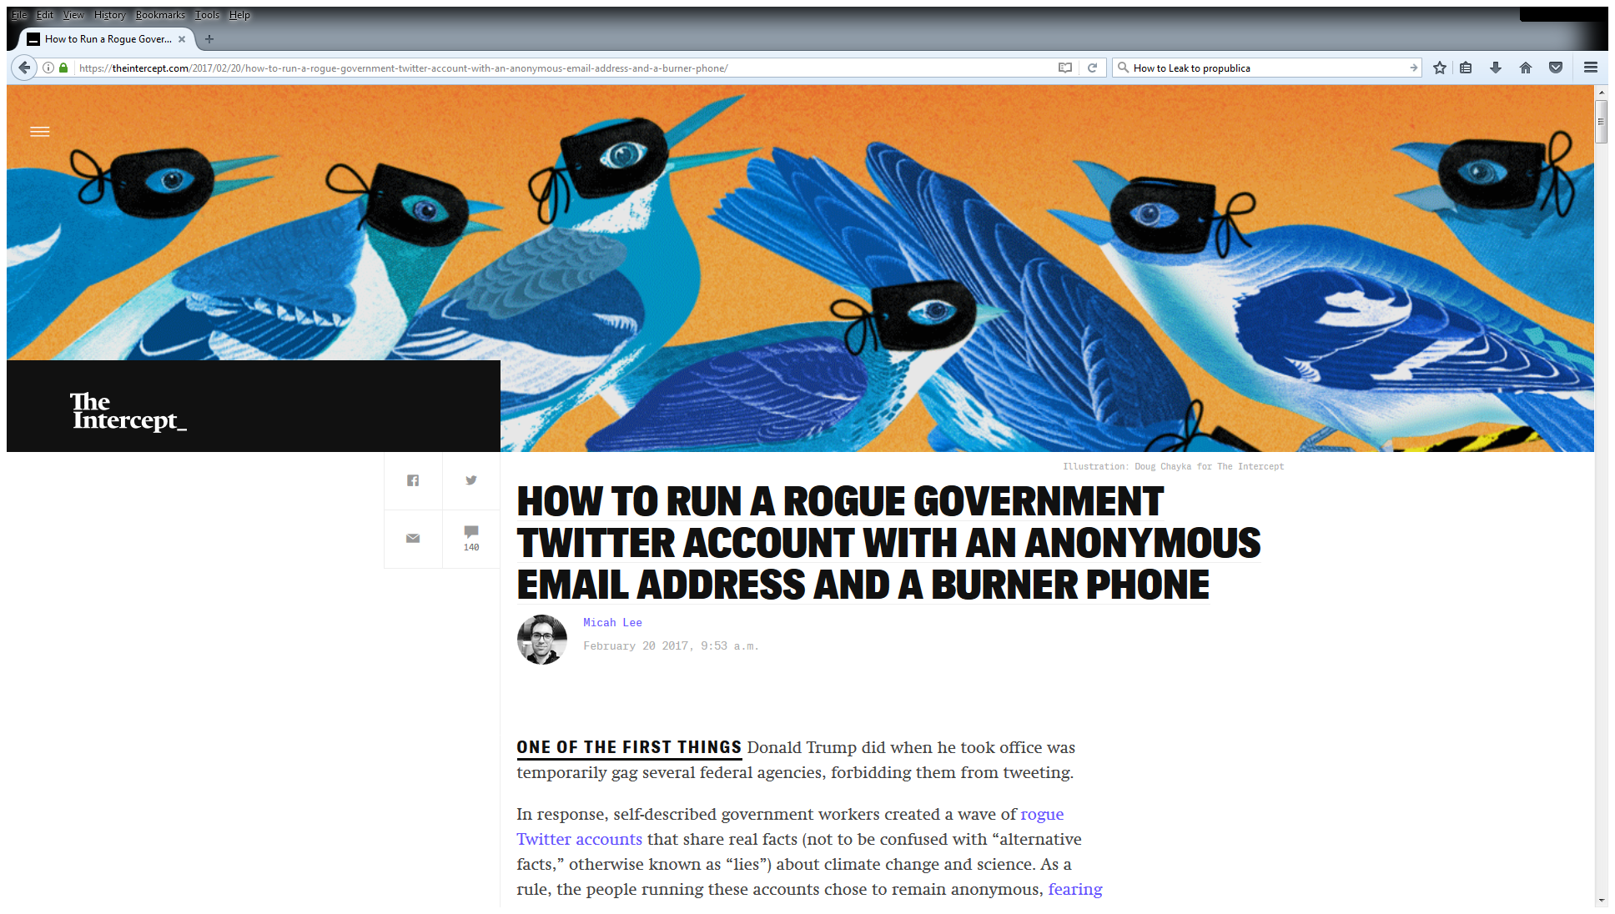

Slide 7
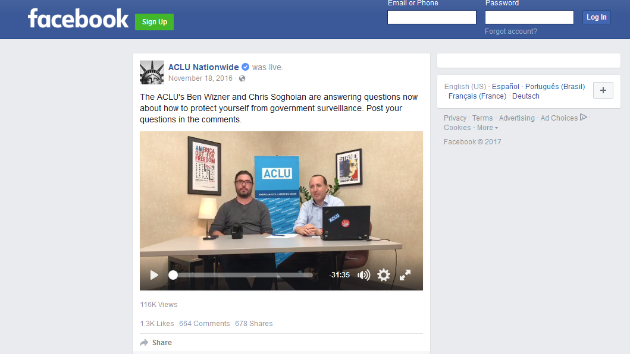
“How to Protect Yourself from Government Surveillance”

Slide 8
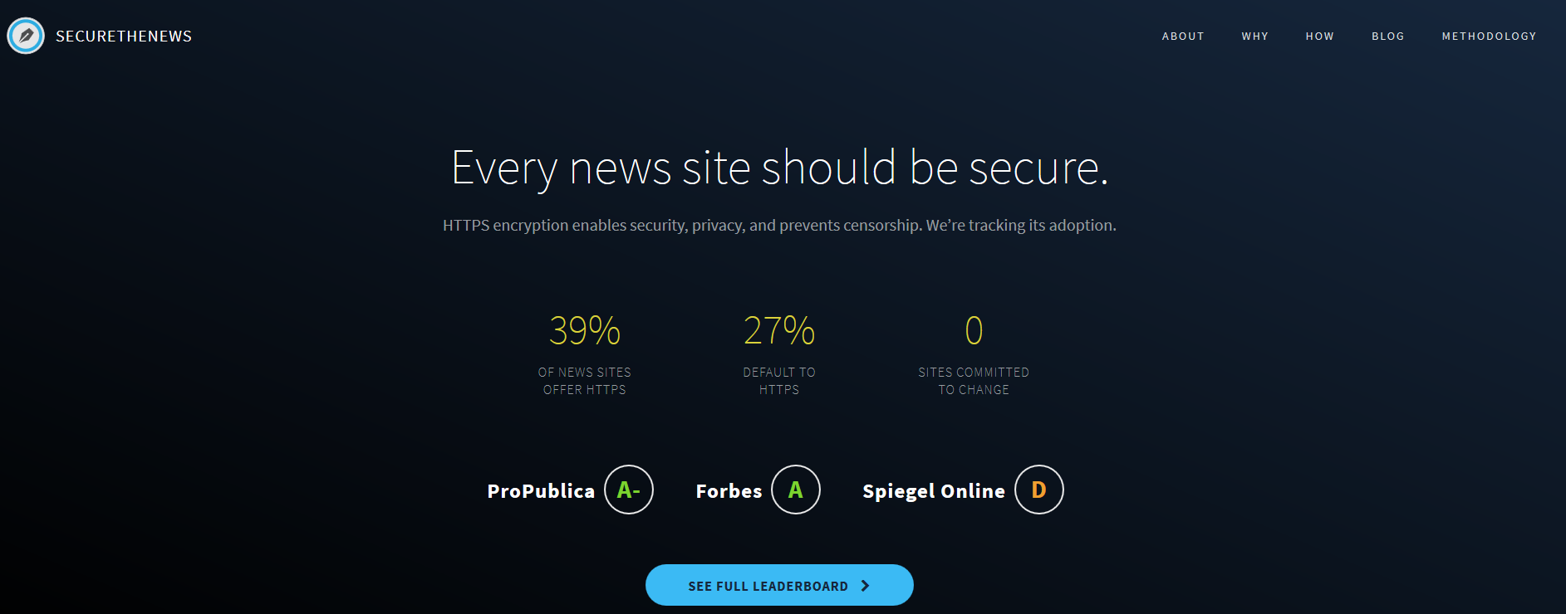

https://securethe.news/

Slide 9
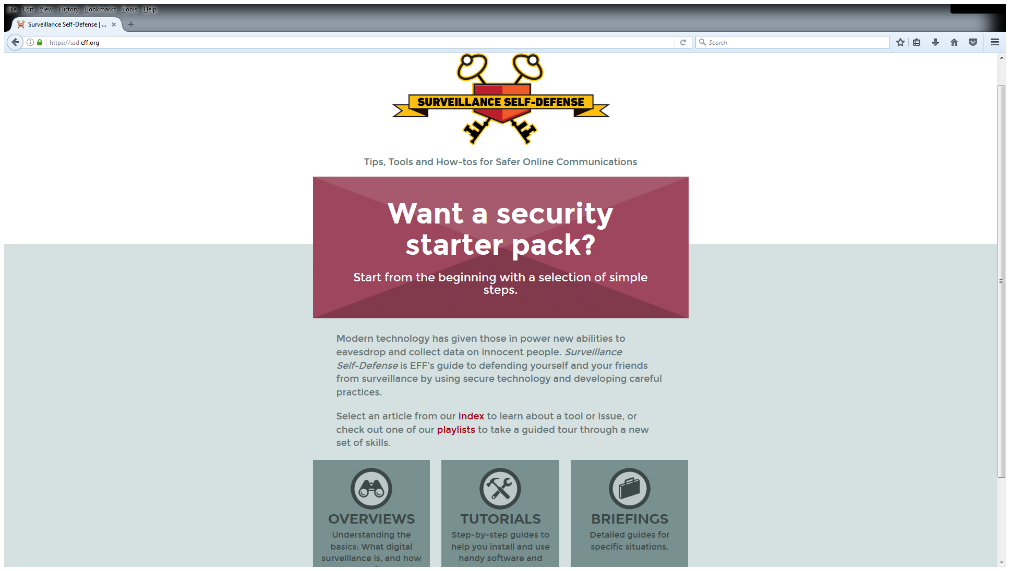
Resources
Nate Cardozo, Electronic Frontier Foundation
Anthony L. Fargo, IU Center for International Media Law and Policy
Marisa Kwiatkowski, Indianapolis Star
Susan Sons, IU Center for Applied Cybersecurity Research

Slide 10
Resources
http://security.engineering/talks/journalists2017/
Susan Sons’ – Cybersecurity Basics and Strategies
These slides

